Slide 1

Constructing a Case Study to Determine EHR Usability
- Merry Monitors
1. Sai Varshith Reddy Gundarapu- Secretary/ Leader
2. Ashwini Dodda- Clinical worker
3. Vaishali Lavangu- Data expert, Graphics expert
4. Sai Sreya Tummala- Librarian/ Chief writer

Slide 2
Introduction:
EHRs available today are incorporated with advanced functionalities like clinical decision support which plays a key role in improving the patient safety and health outcomes. So, it is important to train and educate the users of EHR to effectively use it to its full potential. Understanding various fields in EHR is necessary to input accurate information. Good usability of these functional EHRS had resulted in ease of communication between physicians with regard to interoperability and prevention of medical errors through constant alerts (Rizvi et al., 2017).
Health information technology (HIT), EHRs, and patient portal are often interconnected and go hand in hand. A major challenge associated with poor EHR usability is disruption in the clinical workflow and care coordination which can result in user frustration and productivity loss (Rizvi et al., 2017).
(Rizvi et al., 2017)

Slide 3
Introduction:
Physician burnout is another major issue commonly reported when the clinical staff are not properly trained (Khairat et al., 2019). The initial set up of EHR is quite expensive, improper usage can result in suboptimal utilization and deinstallation of the equipment (Staggers et al., 2013). Compromised patient safety is another usability failure as clinical decision support and evidence-based medicine included in EHRs is not utilized while formulating the diagnosis or treatment protocols. Improper data entry in EHRs can result in prescription errors (Patel et al., 2021, p. 167).
(Khairat et al., 2019) (Staggers et al., 2013) (Patel et al., 2021, p. 167).

Slide 4
Introduction:
EHRs include a lot of functionality to manage and streamline the clinical workflows. When used appropriately, this software saves a lot of time and improve the health outcomes due to their intensive documentation. Training the clinical staff on the advancements is crucial to compensate for burnout and undue stresses (Robinson & Kersey, 2018). Early education about EHRs to the clinical staff and physicians help them to understand various fields in EHR to prevent manual errors while documenting patient data and save their time to record this information. This in turn can maximize the valuable clinical time of clinician with patient. When knowledge about these technologies is gained and properly understood by the physician, tools like CDSS can be used while formulating diagnosis and medical prescriptions to avoid errors to improve patient safety and health outcomes. Ease of recording this information helps the clinical staff with seamless workflows.
(Robinson & Kersey, 2018).

Slide 5
Purpose:
So, in order to dive deeper and learn the functionalities of EHR better, we intent to perform an analysis on Librehealth EHR system.
To achieve this, we therefore constructed case studies on four patients with different diagnosis to interpret and understand the usability of LibreHealth EHR.

Slide 6
Methods:
Each case study needs to be included with a diagnosis, medication, coding terminology.
We looked up for references from internet to find apt medication to the given condition and dosage requirements.
One of the tasks mentioned to add a misadventure to the patient. So, we looked up for ICD-10 codes on internet starting with ‘V’ or ‘W’ to learn about misadventures.
Later, we researched the needed medication and dosage needed to treat this misadventure.

Slide 7
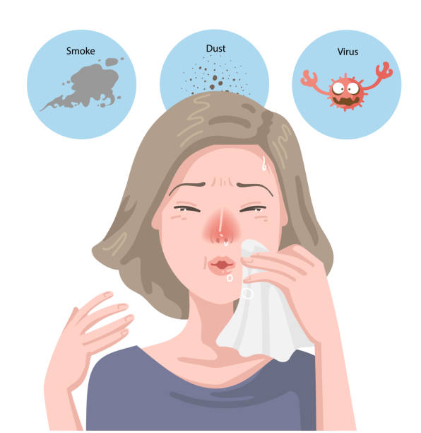
Results:
Description of Case Study-1 :
A 27- year- old male named Harsha Mohit had visited the clinic with a chief complaint of headache and running nose. General physical examination was performed along with complete blood picture and vitals recorded. Everything seemed to be normal. A provisional diagnosis of sinusitis was made based on the chief complaint and initial examination. To validate this diagnosis and formulate a final diagnosis, an endoscopy was performed which confirmed the provisional diagnosis. Fluticasone propionate nasal spray in the form of suspension was prescribed to the patient with a dosage of 93mcg to be taken through each nostril two times a day (Mayo Clinic, 2021).
Image URL: https://www.istockphoto.com/vector/allergic-gm1097657556-294771884
(Mayo Clinic, 2021).

Slide 8

After few days, on 7/30/2022, the patient was seen at the emergency clinic reporting motorcycle accident. The patient was presented with bleeding from multiple body sites. On examination, head injury was detected. Basic first aid was performed to the patient to control bleeding. A referral visit is scheduled for the patient to visit the neurologist. Later MRI scan was performed to diagnose the head injury. Results indicated there was no damage and prophylactic medication was prescribed. 10 tablets of carbamazepine 200 mg was given to be taken twice daily for five days (Mayo Clinic, 2021). An ointment neosporin of 28 grams was prescribed to be applied on injured areas thrice daily (WebMD, n.d.). In order to relieve the mild body aches the patient might experience, acetaminophen of dosage 325mg was prescribed to be taken 3 times a day orally for a week. A follow up appointment was created after 2 weeks. At the follow up, injuries seemed to be healed and the prophylactic medication, carbamazepine was discontinued. Patient is advised to apply the topical ointment and take the acetaminophen when pain is felt.
Image URL: https://www.dreamstime.com/royalty-free-stock-image-motorcycle-accident-hand-drawn-cartoon-characters-image31896266
(Mayo Clinic, 2021) (WebMD, n.d.).

Slide 9
Problems faced so far:
The patient appeared at the emergency department for a misadventure concern, but we were not able to assign emergency visit at the new encounter.
We were not able to edit the medical problem list once an issue was added.
The assigned begin date to a medical problem is not being reflected on the ‘Issues’ field.
In the review of systems, the changed fields were neither being saved to the patient history nor being reflected anywhere in the patient chart.
We were not able to edit the future appointment tab in relation to date and time of appointment.

Slide 10
Discussion:
Entering the patient data and detailing the medical concerns of the patient consumes a lot of time which critically reduces the clinical time of the physician with the patient. This results in physician burn out as well. Many of the EHR experts have pointed out cognitive challenges which results from poor EHR usability. Also, another challenge that poor usability could cause is imperfectly formatted information leading to improper adaption of physicians to technical advances(Patel et al., 2021). Poor usability is also major hurdle in the process of adopting to electronic health care systems from traditional paper-based methods (Khan et al., 2017).
(Patel et al., 2021) (Khan et al., 2017).

Slide 11
Future work:
As a team, we intend to construct similar case studies for three more patients understanding different functionalities of LibreHealth EHR system.
We plan on documenting the hardships faced during the recording of patient data to the EHR system.
To thoroughly explore various data fields in LibreHealth EHR to include apt diagnosis and ICD-10 coding to the given condition of the patient.
Analyze different features in the LibreHealth EHR to find serious usability issues and try to find methods to fix them.

Slide 12
References:
Khairat, S., Coleman, C., Ottmar, P., Bice, T., Koppel, R., & Carson, S. S. (2019). Physicians’ gender and their use of electronic health records: Findings from a mixed-methods usability study. Journal of the American Medical Informatics Association, 26(12), 1505–1514. https://doi.org/10.1093/jamia/ocz126
Patel, V. L., Kaufman, D. R., & Kannampallil, T. (2021). Human-Computer Interaction, Usability, and Workflow. In Shortliffe, E. H. & Cimino, J. J. (Eds.) & Chiang, M. F. (Co-Ed.). (2021). Biomedical informatics: Computer applications in healthcare and biomedicine. (5th ed.). New York: Springer.
Mayo Clinic. (2021, August 27). Acute sinusitis. https://www.mayoclinic.org/diseases-conditions/acute-sinusitis/diagnosis-treatment/drc-20351677
Mayo Clinic. (2021, February 04). Traumatic brain injury. https://www.mayoclinic.org/diseases-conditions/traumatic-brain-injury/diagnosis-treatment/drc-20378561#:~:text=Mild%20traumatic%20brain%20injuries%20usually,persistent%2C%20worsening%20or%20new%20symptoms.

Slide 13
Rizvi, R. F., Marquard, J. L., Hultman, G. M., Adam, T. J., Harder, K. A., & Melton, G. B. (2017). Usability evaluation of electronic health record system around clinical notes usage-an ethnographic study. Applied Clinical Informatics, 8(4), 1095–1105. https://doi.org/10.4338/ACI-2017-04-RA-0067
Robinson, K. E., & Kersey, J. A. (2018). Novel electronic health record (EHR) education intervention in large healthcare organization improves quality, efficiency, time, and impact on burnout. Medicine, 97(38), e12319. https://doi-org.proxy.ulib.uits.iu.edu/10.1097/MD.0000000000012319
Staggers, N., Xiao, Y., & Chapman, L. (2013, May 28). Debunking health IT usability myths. Applied Clinical Informatics. https://www.ncbi.nlm.nih.gov/pubmed/23874361
WebMD. (n.d.). Neosporin ointment- uses, side effects, and more. https://www.webmd.com/drugs/2/drug-3744/neosporin-neo-bac-polym-topical/details

Slide 14
Image references:
Viyadaistock. (2019). Allergic stock illustration [Digital]. iStock, Alberta, Calgary, Canada. https://www.istockphoto.com/vector/allergic-gm1097657556-294771884
DreamsTime. (2013). Motorcycle accident- hand drawn characters [Digital Drawing]. Bucharest, Romania. https://www.dreamstime.com/royalty-free-stock-image-motorcycle-accident-hand-drawn-cartoon-characters-image31896266

Slide 15

Thank you

